Slide 1
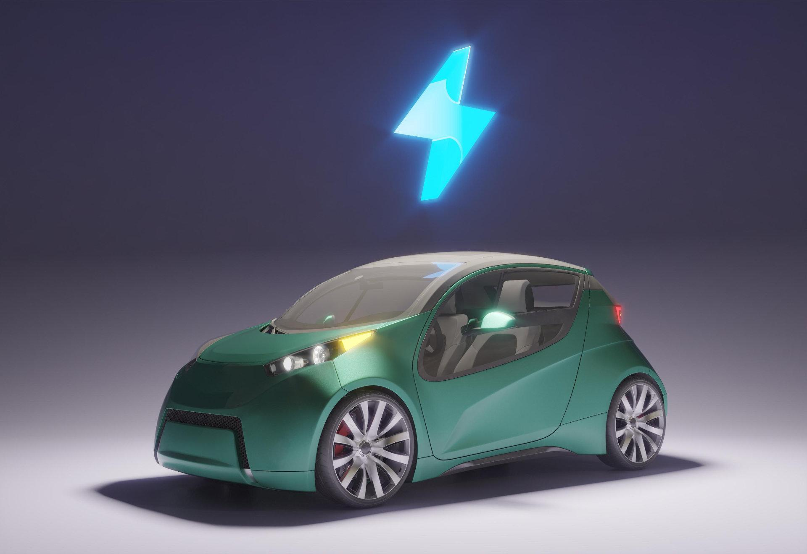
Wireless Charging Of Electric Vehicles

Slide 2
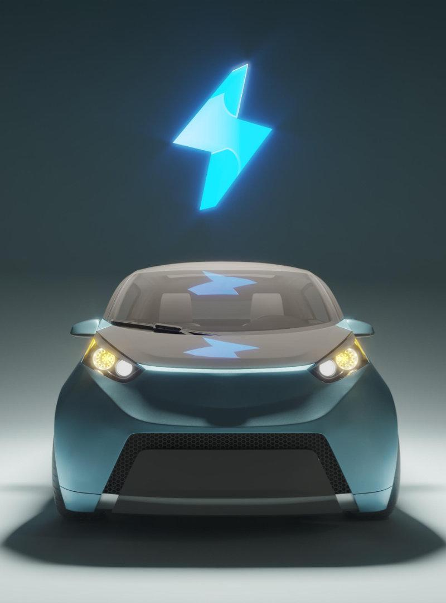
01
Introduction

Slide 3
The eco-friendly vehicle is the global trend in the automobile industry.
The electrical vehicle (EV) is the most suitable alternative of petroleum vehicles.
The large capacity, weight, expensive price, short life time, and charging time of battery obstruct the commercialization of EV.
To solve these problems, wireless charging of electric vehicle is introduced.

Slide 4
02
What is wireless charging

Slide 5
Wireless charging uses an electromagnetic field to transfer energy between two objects through electromagnetic induction.
Energy is sent through an inductive coupling to an electrical device, which can then use that energy to charge batteries or run the device.

Slide 6
03
Types of wireless charging

Slide 7
Battery Switching
Depleted EV battery pack is switched with a fully charged battery pack in the switching station.
Conductive Charging
It utilizes connector between the electric power source and battery.
Inductive Charging
Wireless charging coupled with magnetic resonance to transfer power for a transmitting pad to a receiving pad.

Slide 8
04
Working principle

Slide 9
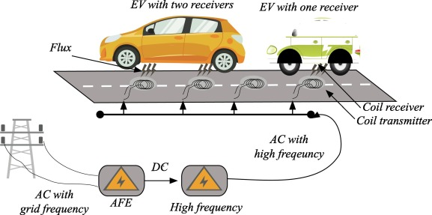
It is based on the same principle as transformer. Here there are transmitter and receiver. The supply is 220V, 50Hz AC. It is converted to high frequency alternating current and this current is supplied to transmitter coil. Because of this a magnetic field is created which cuts the receiver coil and ac power output is produced in receiver. The ac power at receiver is rectified to dc and it is then fed to the battery through BMS.

Slide 10

Specifically, the technology works by generating 20kHz frequencies into an electromagnetic field by a power inverter which are embedded.
Wireless charging Electric Vehicles are built with an on-board pick up device that allows an electric vehicle to be powered by an underground power line while driving.
This allows the vehicle to carry 4/5 less battery capacity or weight, because it only requires a small battery for minimal operations off the power grid.

Slide 11
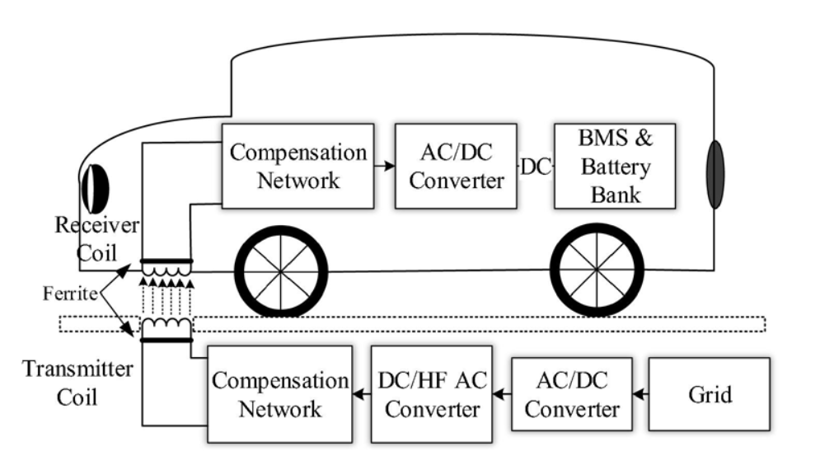

Slide 12
05
CIRCUIT DIAGRAM

Slide 13
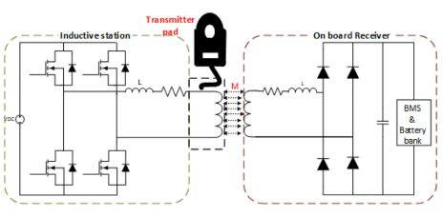

Slide 14
06
EQUATIONS USED

Slide 15
K=M/(Ls*Lp) where
K-coupling coefficient
M-Mutual flux
Lp=primary leakage flu
Ls=secondary leakage flux
w(omega)=2*pi*frequency=2*pi*50000=3.14*10^5
ws(omega s)=w^2=9.8696*10^10
Capacitance(primary)=1/(ws*Lp)=1/((9.8696*10^10)*(10^-3))=1.0132*10^-8F
Capacitance(secondary)=1/(ws*Ls)=1.0132*10^-8F
INPUT VOLTAGE=400V

Slide 16
07
SIMULATION

Slide 17
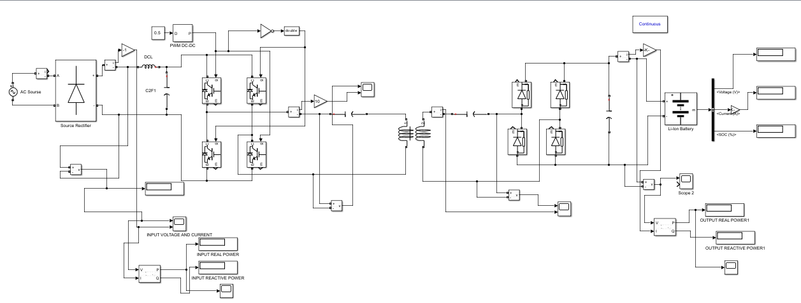

Slide 18
08
RESULTS

Slide 19
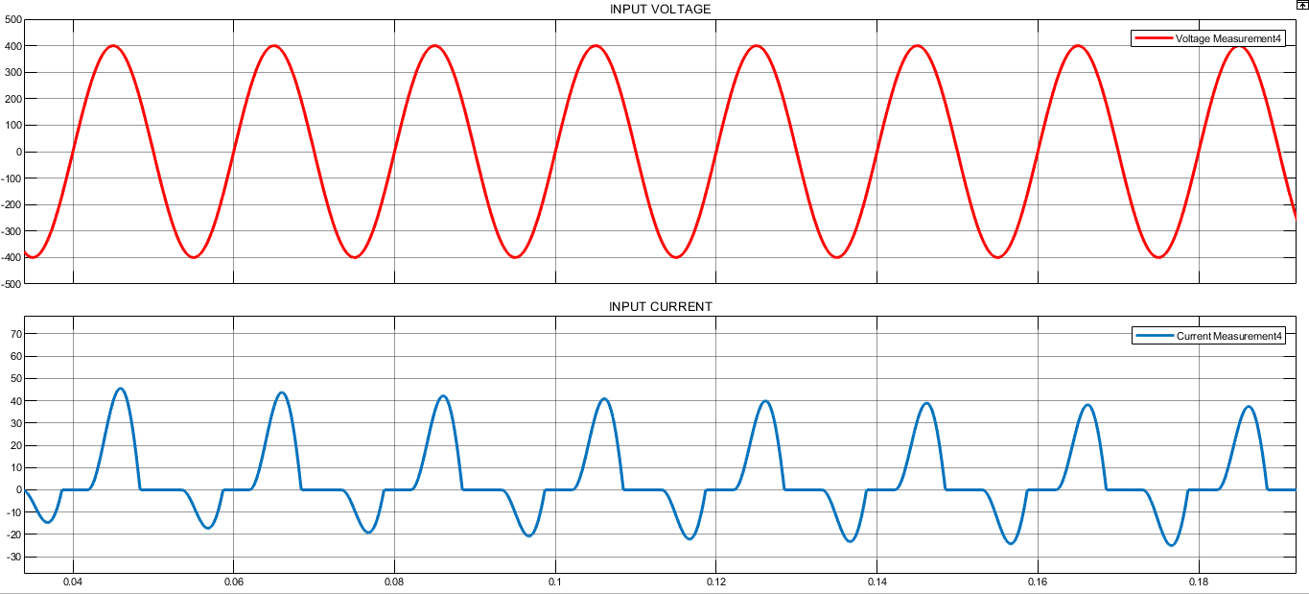

Slide 20
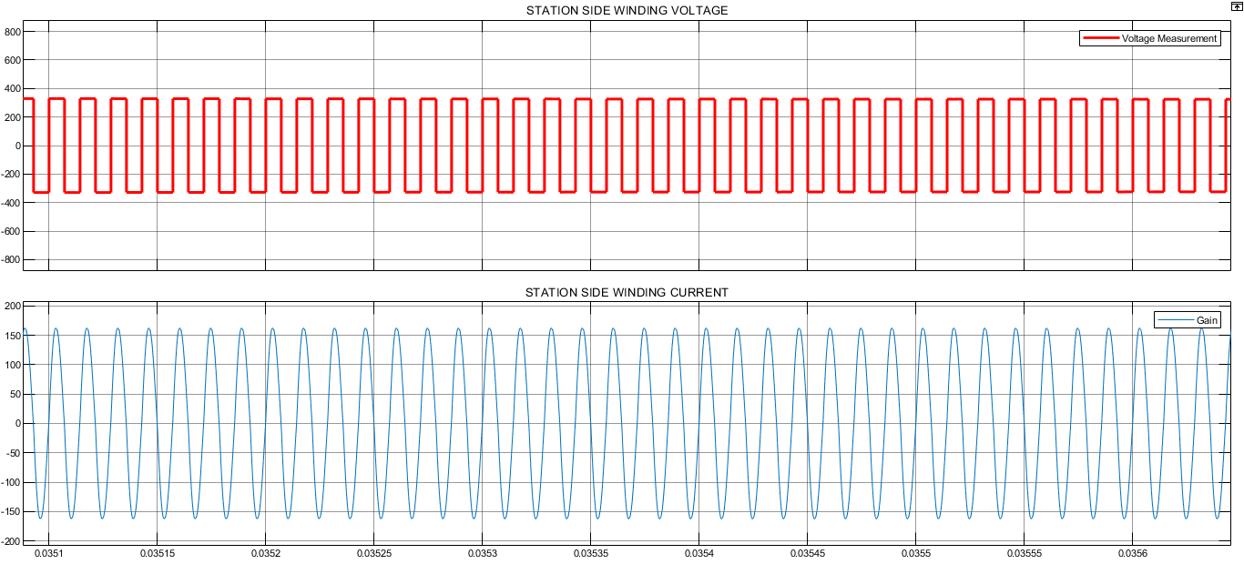

Slide 21
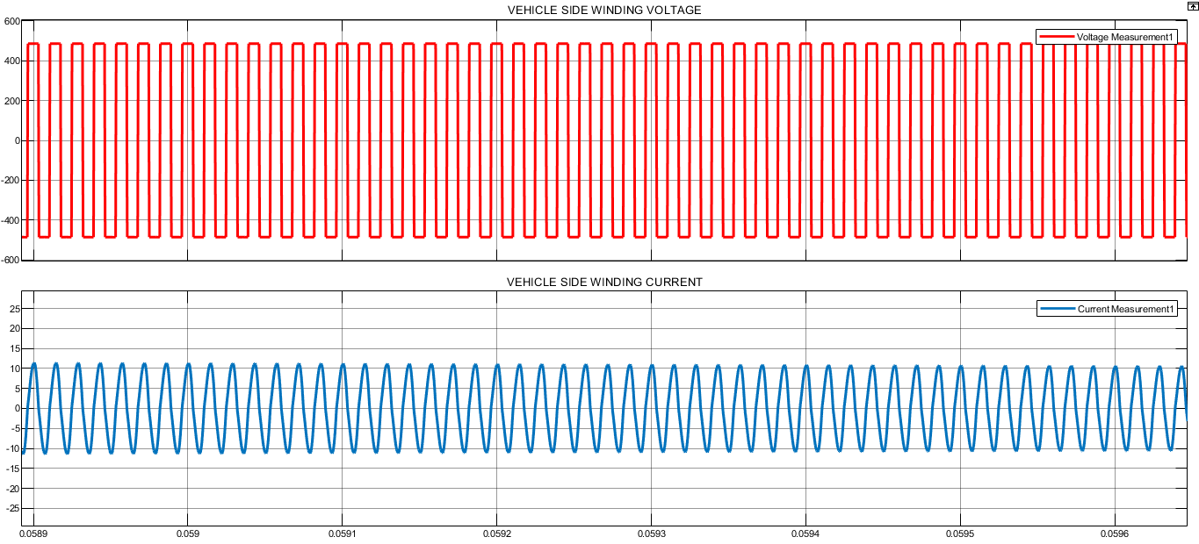

Slide 22
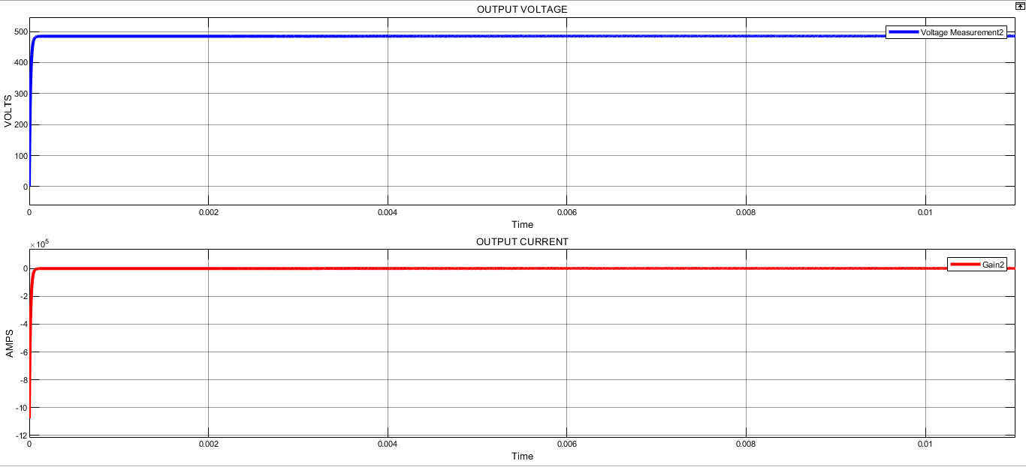

Slide 23
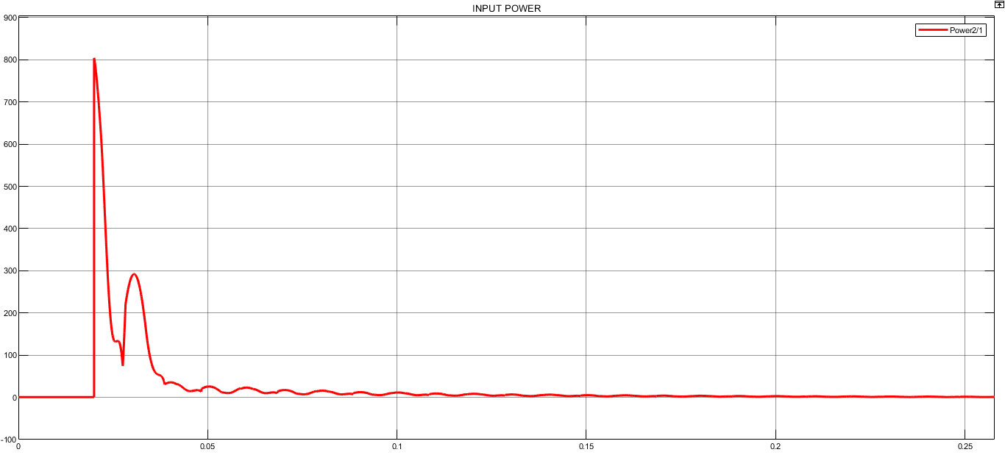

Slide 24
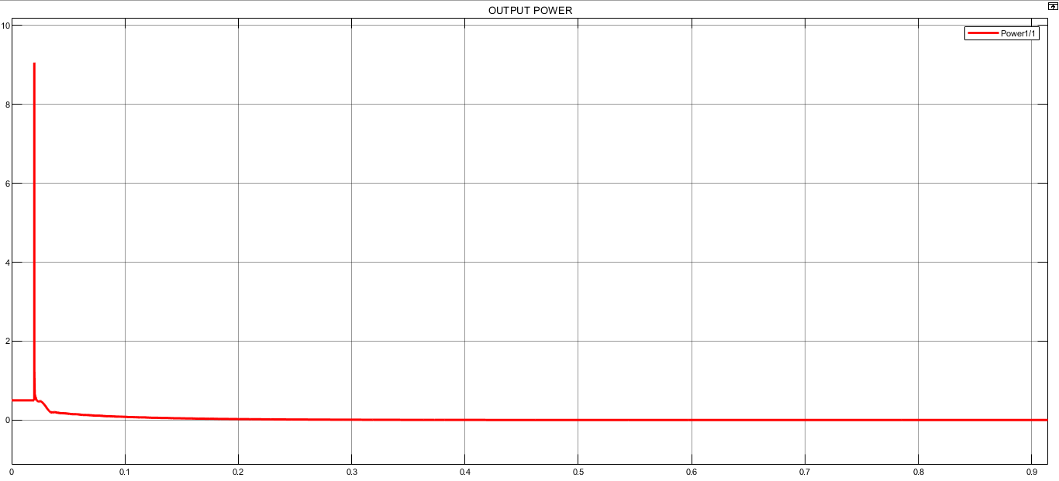

Slide 25
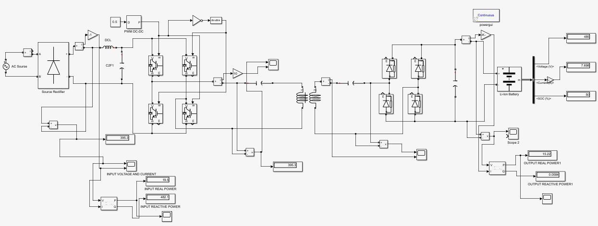
Here the efficiency is 78.05%.

Slide 26
09
Conclusion

Slide 27
Low maintenance cost but high initial cost
Energy crisis can be decreased
Low power loss
Better than conventional wired system

